Slide 1

mvgr blog bundle
By: Batch 07
D.HUSSAIN - 19331A1216
A.RAJA - 19331A1203
M.AKSHAYA - 19331A1235
CH.VAISHNAVI - 19331A1210
PROJECT CO-ORDINATOR:
DR. B. ANJANADEVI
ASST.PROFESSOR
IT DEPARTMENT
Academic Co-Ordinator:
Dr. T. Pavan Kumar
Department Of Information Technology
MVGR College Of Engineering(Autonomous)
Vizianagaram
June 2022
Head Of The Department:
Dr. V. Nagesh

Slide 2
ABSTRACT
ABSTRACT
Blog is a regularly updated website or web page, typically a one run by an individual or small group, that is written in an informal or conversational style. A user needs to create an account in order to post content or view the content that belongs to the particular website.
Blogs are usually maintained by an individual with regular entries of commentary, descriptions of events, or other material such as graphics or video.
The software for writing blogs can be divided into user hosted and developer hosted

Slide 3
INRTODUCTION
A blog is a type of website or part of a website, which is the publication of regular articles over time in some area of personal or professional interest. Blog can also be used as a verb, meaning to maintain or add content to a blog.
There are many different types of blogs, differing not only in the type of content, but also in the way that content is delivered or written.
Blogs are usually maintained by an individual with regular entries of commentary, descriptions of events, or other material such as graphics or video.

Slide 4
PROBLEM STATEMENT
The project “MVGR BLOG BUNDLE” is a blogging application or website related to MVGR college of engineering, the students and staff of the college will have the access to the website.
It allows us to write blogs on different topics by different people . The website provides some categories, the blogs which are written by the users are categorized into these categories. This website also has a community environment between the users.

Slide 5
MODULES
1. Login module:
In this module it is seen that only college folks will be using the website so that we can identify the person for a particular blog related stuff. This can be made by using college mail id as the primary mail for logins.
In the next part, mail id and password should be correctly matched for the login.
2 .Blog creation module:
In this module in the creation part the user can give title and required amount of description for the blog.
In this module only the user should select to which category the blog belongs too.

Slide 6
MODULES
3. Blog access:
Everyone will have not have the access to edit the blog of some other user. Instead, only view access will be given to the other users.
The blog creator and the admin will have the access to edit blog.
4. Search module:
Word will be used as keyword, and the blog that containing that word will be displayed.
5. Filter module:
In this module filter is applied only the filtered category blogs will be displayed.

Slide 7
SOFTWARE REQUIREMENTS
PYCHARM :
PyCharm is an integrated development environment (IDE) used in computer programming, specifically for the Python language. Community Edition of PyCharm is used here of version 2021.1.2
HTML:
HTML is used to create electronic documents (called pages) that are displayed on the World Wide Web. Each page contains a series of connections to other pages called hyperlinks.
CSS:
Cascading style sheets are used to format the layout of Web pages. They can be used to define text styles, table sizes, and other aspects of Web pages that previously could only be defined in a page's HTML.

Slide 8
SOFTWARE REQUIREMENTS
FRAMEWORK(DJANGO):
Django is a web application framework written in Python programming language. It is based on MVT (Model View Template) design pattern. Version of 4.0.3.
It takes less time to build application after collecting client requirement.
POSTGRESQL(pgAdmin 4):
PostgreSQL is a powerful, open source object-relational database system that uses and extends the SQL language. pgAdmin 4 of version 6.7 is used for the backend combined with many features that safely store and scale the most complicated data workloads.

Slide 9
HARDWARE REQUIREMENTS
System : Intel(R) core(TM) i5
Hard disk : 1 TB
Input Devices : Keyboard , Mouse
RAM : 8 GB
64-bit Operating system,x64-based processor

Slide 10
EXISTING SYSTEM
A blog is a discussion or informational website published on the World Wide Web consisting of discrete, often informal diary-style text entries.
The evolution of electronic and software tools to facilitate the production and maintenance of Web articles posted in reverse chronological order made the publishing process feasible to a much larger and less technically-inclined population. Ultimately, this resulted in the distinct class of online publishing that produces blogs we recognize today.
For instance, the use of some sort of browser-based software is now a typical aspect of "blogging". Blogs can be hosted by dedicated blog hosting services, on regular web hosting services, or run using blog software.

Slide 11
PROPOSED SYSTEM
A student as a part of our college shows interests in various things going on in that college. What would a student do if he/she requires-information of that college?
As time changes, interests and, requirements and wants change too. For example, the same student was interested in a sport and joined a sports club in his initial year of study.
This blog website is the solution for all the problems, users can login into website and fetch the required data and use the beneficiary programs available in the college.

Slide 12
SYSTEM ARCHITECTURE
Manage Blog Details
Admin
Login to system
Check roles of access
Manage Create Blog Details
Forgot password
Check credentials
Manage modules
Manage Web page Details
Send email to user
Manage Comment Details
Manage System Admins
Manage roles of User
Manage User Permission
Manage Report
Manage Publish Details

Slide 13
OUTPUT SCREENSHOTS

Slide 14
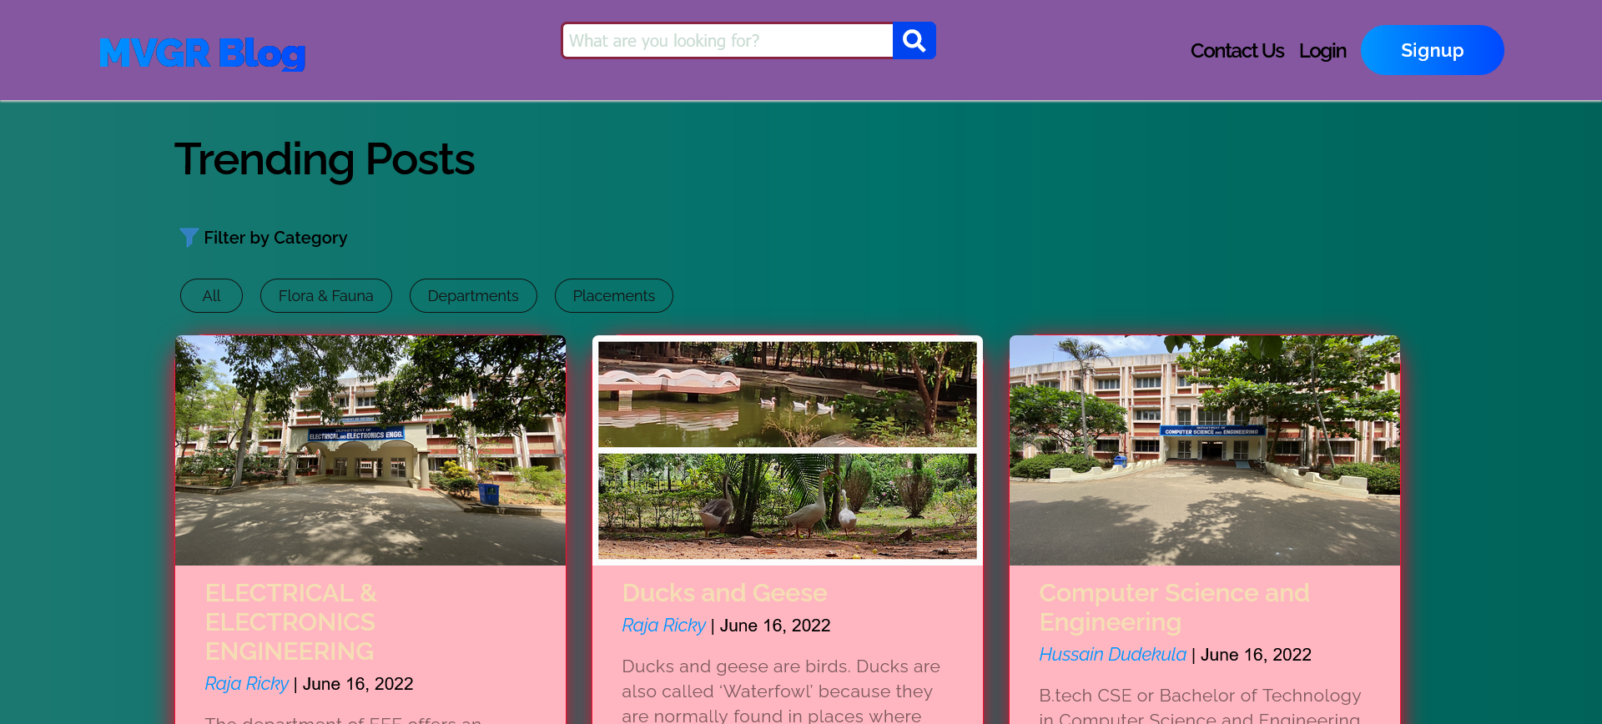

Slide 15
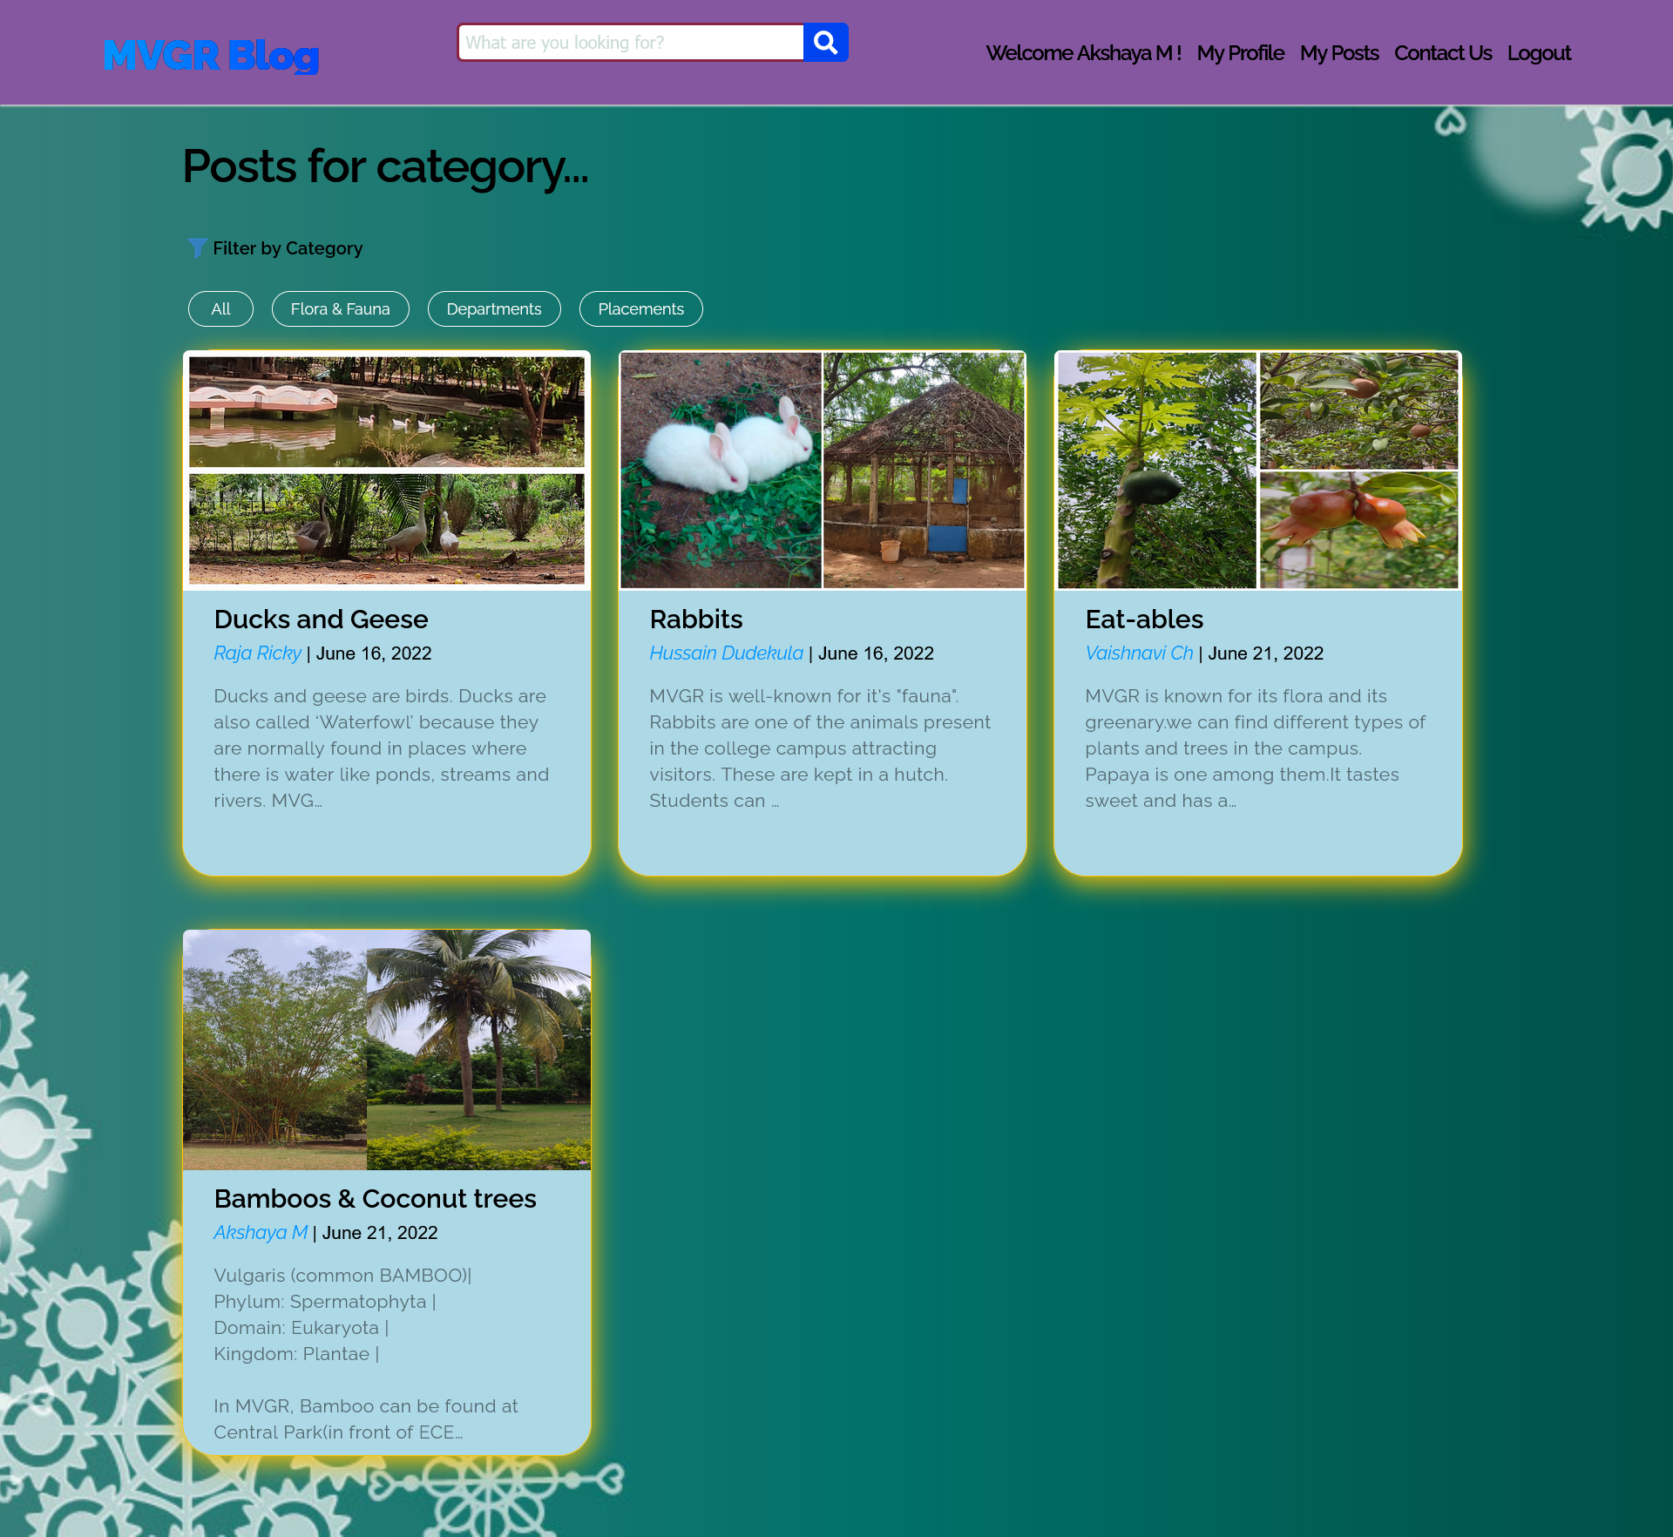

Slide 16
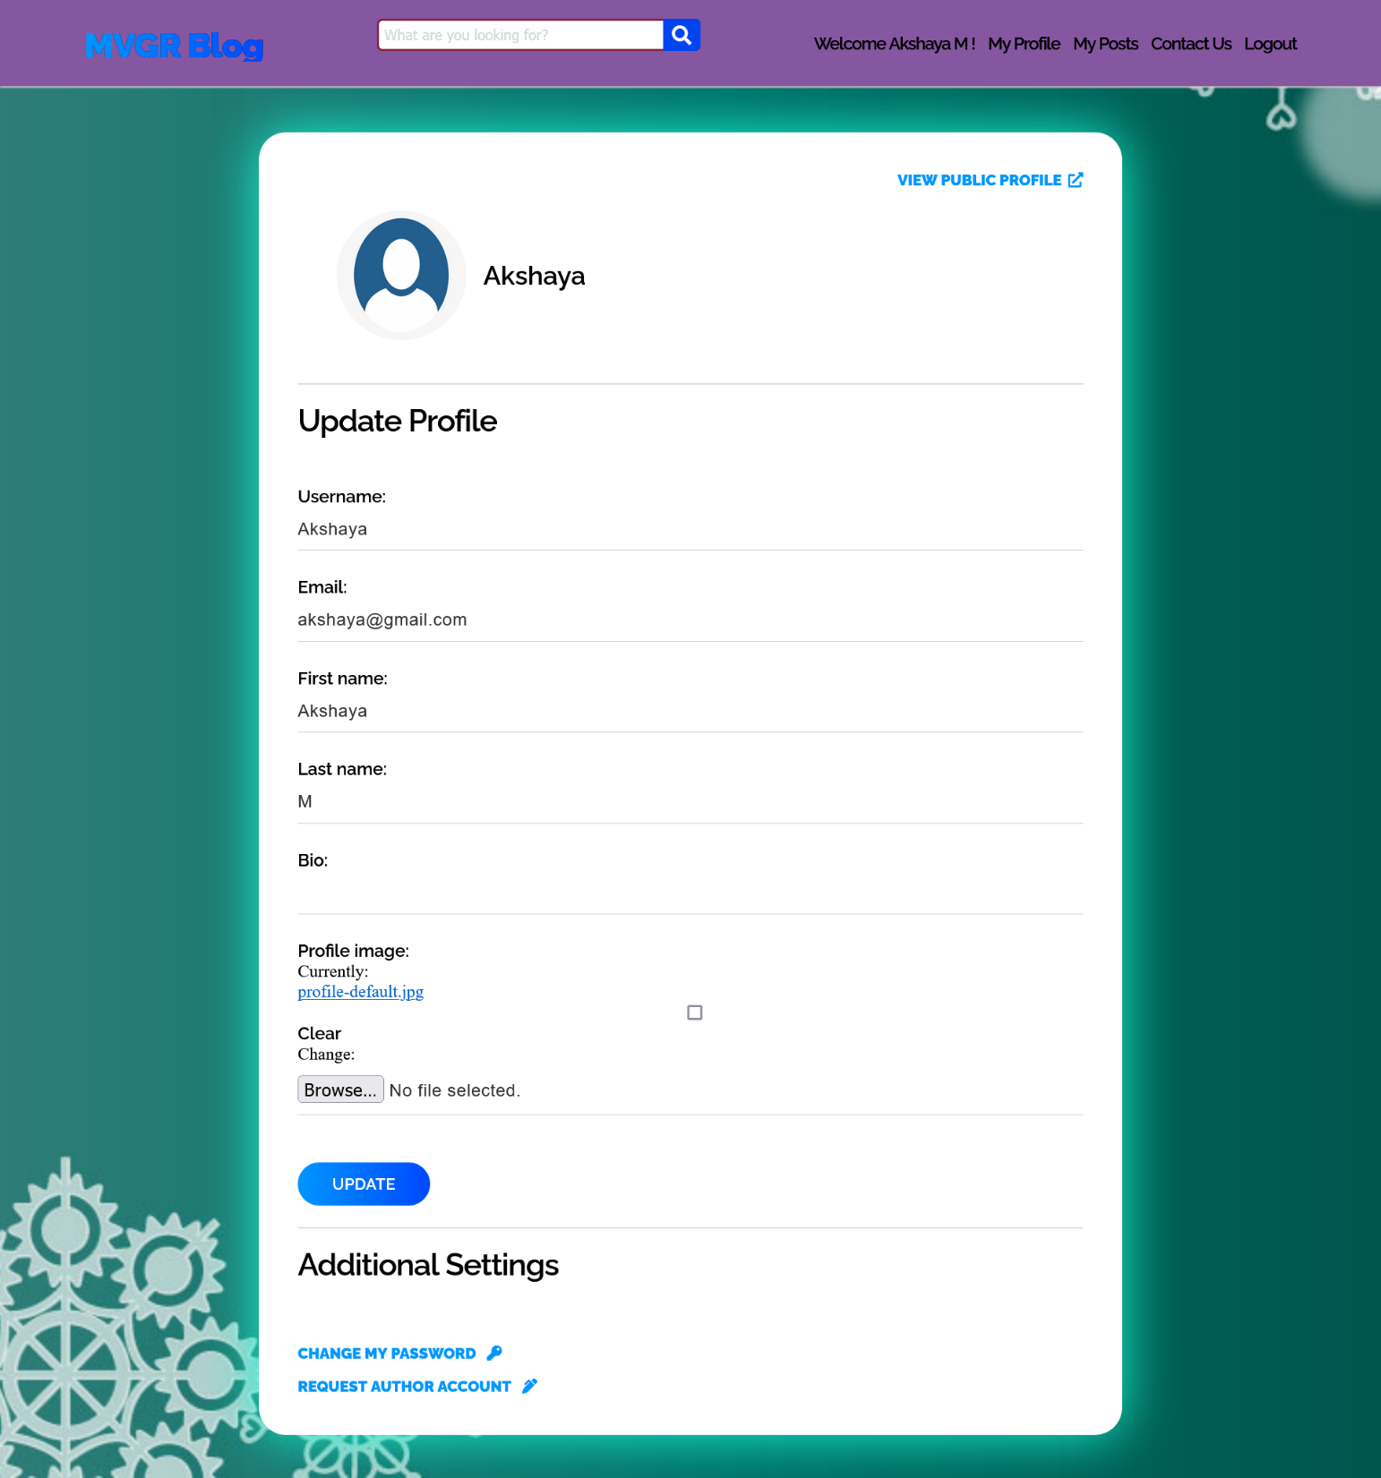

Slide 17
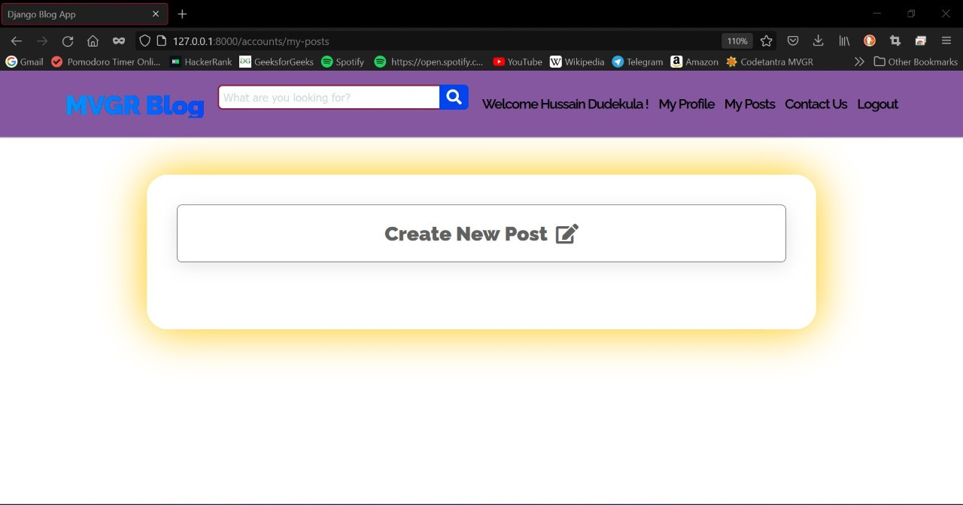

Slide 18
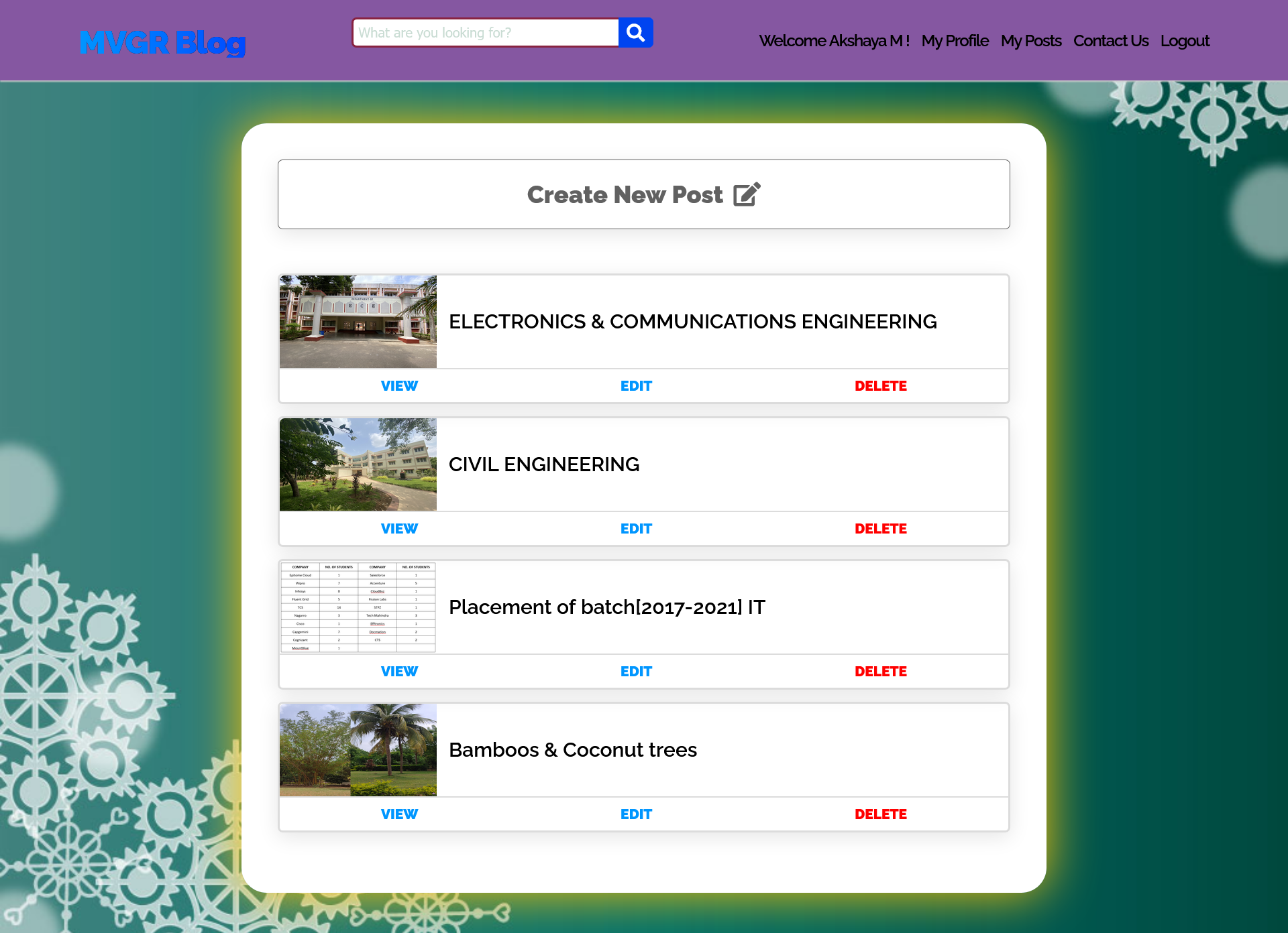

Slide 19
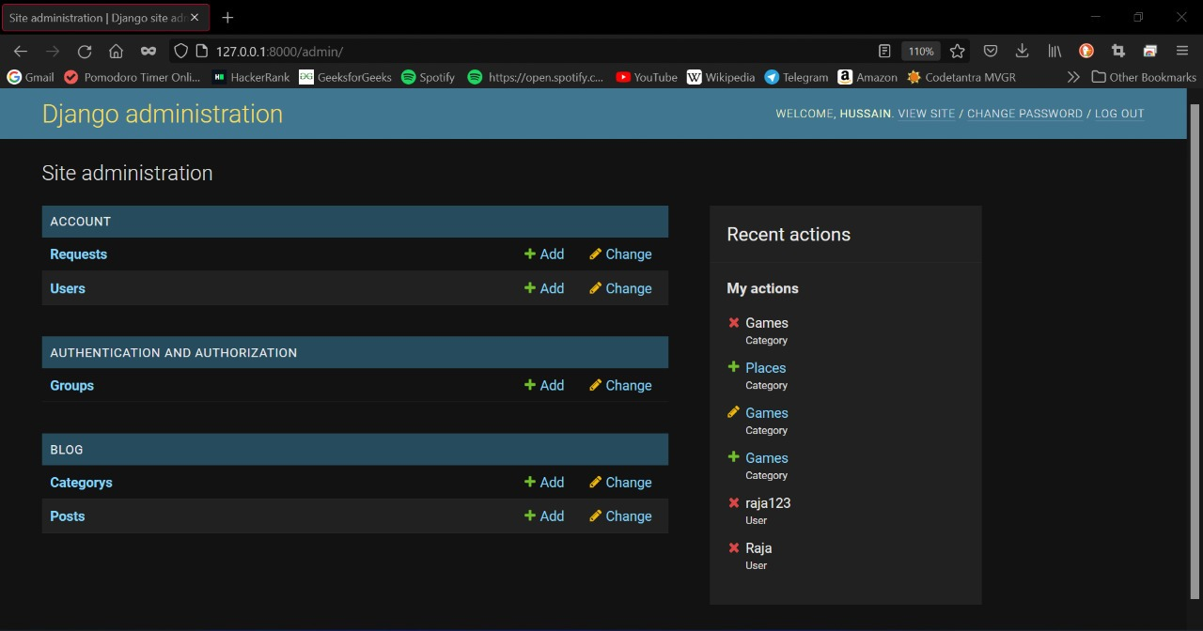

Slide 20
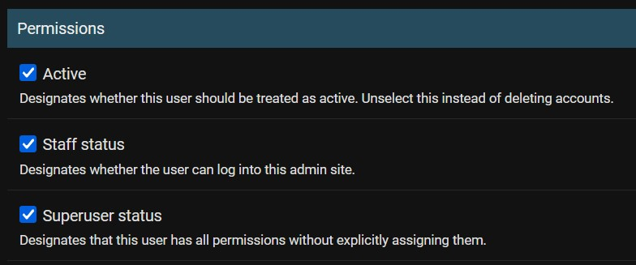

Slide 21
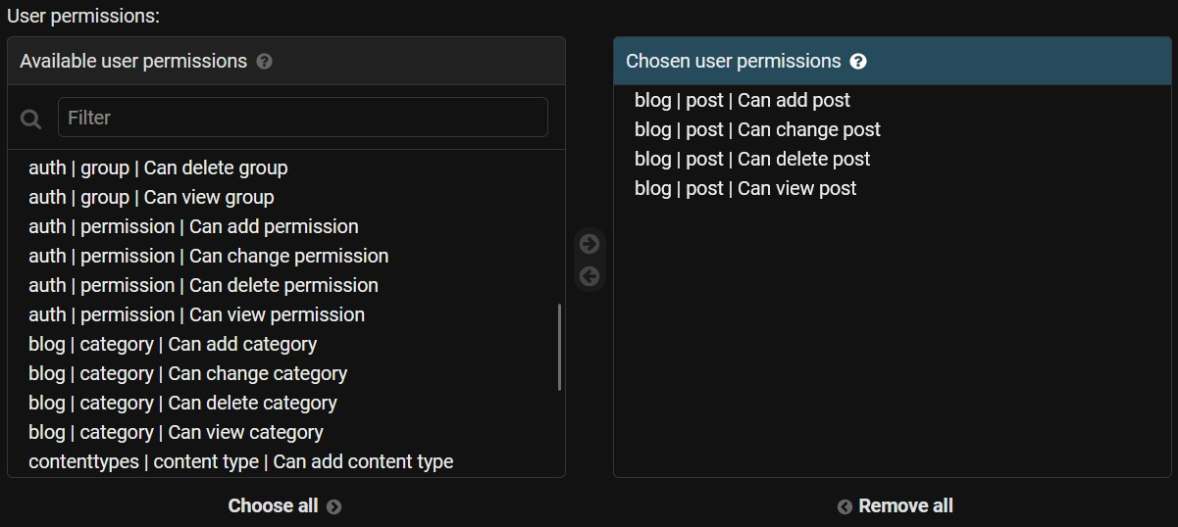

Slide 22
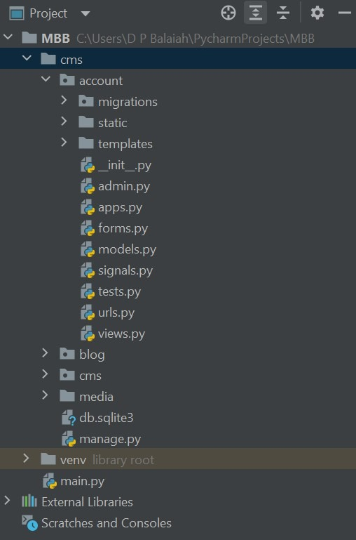
PROJECT STRUCTURE

Slide 23
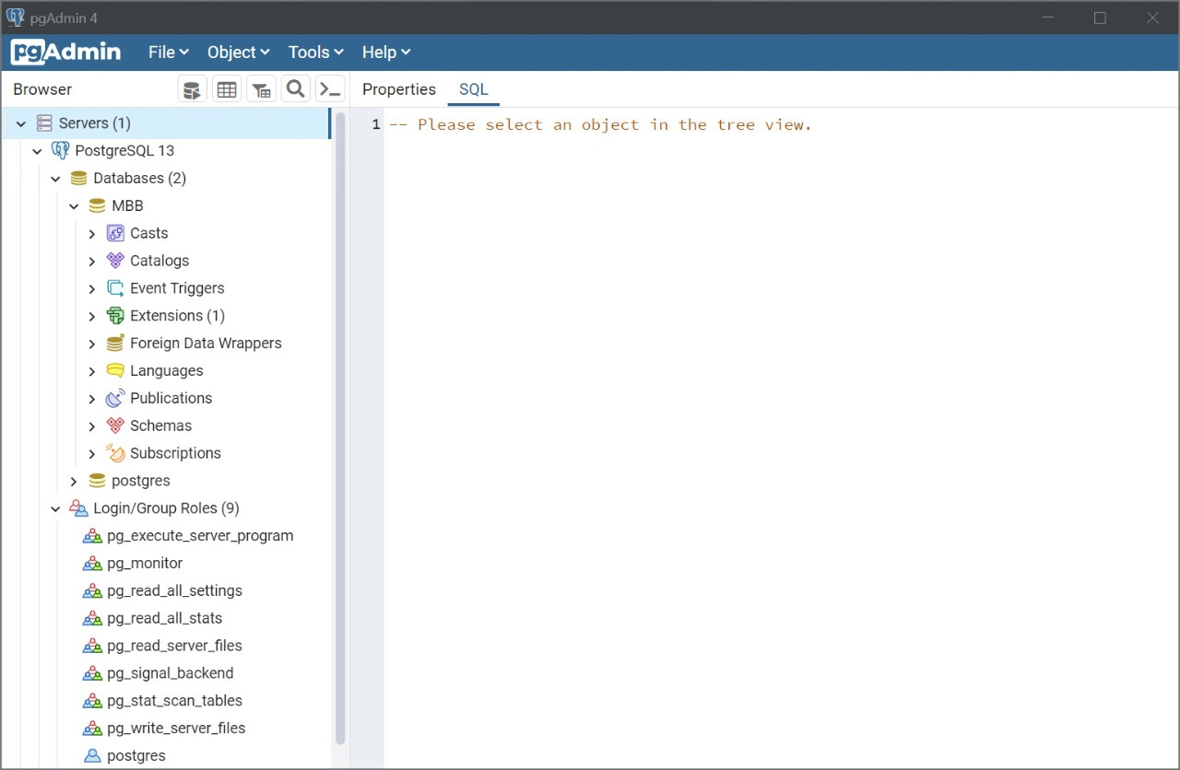
DATABASE STRUCTURE

Slide 24
CONCLUSION
MVGR blog bundle is not just a website it encounters and resolves all the information regarding issues up to high extent. Users can login into website and fetch the required data and use the beneficiary programs available in the college. The people who are interested in writing would be highly beneficial using this platform as this platform also promotes students to express their writing skills in a highly collaborative and creative way

Slide 25
REFERENCES
Django: https://www.djangoproject.com/
W3 Schools – Django: https://www.w3schools.com/django/index.php
MVGR College of Engineering Official Website: https://www.mvgrce.com/
PostGreSQL: https://www.postgresql.org/
Pycharm: https://hackr.io/blog/what-is-pycharm

Slide 26


